Slide 1
ZIPPYCOM APPLICATION USING SWIFT IN IOS
Submitted By,
Name :- Ankit Senjaliya
Enrollment No. :- 19BT04046
Course :- B.Tech Computer Science and Engineering

Slide 2
INTRODUCTION
ZippyCom offers the fastest, most reliable, safe and affordable method to bring skilled service to you – anywhere in the world! Select your preferred service, check the map to see which providers are working nearby, and select based on price and reviews. All payments are made securely through PayPal. Available in Multiple Language.
Just one click to bring unbeatable services anywhere you are.
Our providers set their own prices. You are able to see which provider in your area is offer the best deal for your job.
We will provide you with the means to ensure that your personal information is correct and current. You may review and update this information at any time at the Visitor Center.

Slide 3
View and edit personal information you have already given us.
Tell us whether you want us to send you marketing information, or whether you want third parties to send you their offers by postal mail.
Sign up for electronic newsletters about our services and products.
Register :- Once you register, you won't need to do it again. Wherever you go on ZippyCom.com, your information stays with you.

Slide 4
OUR SERVICES
Car Wash Service :- Choose from 3 different levels of service: Quick wash, Standard wash, or Delux Detailing for a super shiny finish.
Snow Removal Service :- Stay warm inside while we shovel your sidewalk, driveway and porch. We will also clear your car saving you extra time.
Leaf Removal Service :- Enjoy the beauty of autumn's colors without the hassle of raking a yard full of leaves. Service available up to 1 acre.
Lawn Service :- Your home will be the pride of the neighborhood with your neatly trimmed lawn. Service up to 1 acre.

Slide 5
REQUIREMENTS
Platform :- XCode
Front - End :- IOS
Back - End :- API in Laravel
Language :- Swift

Slide 6

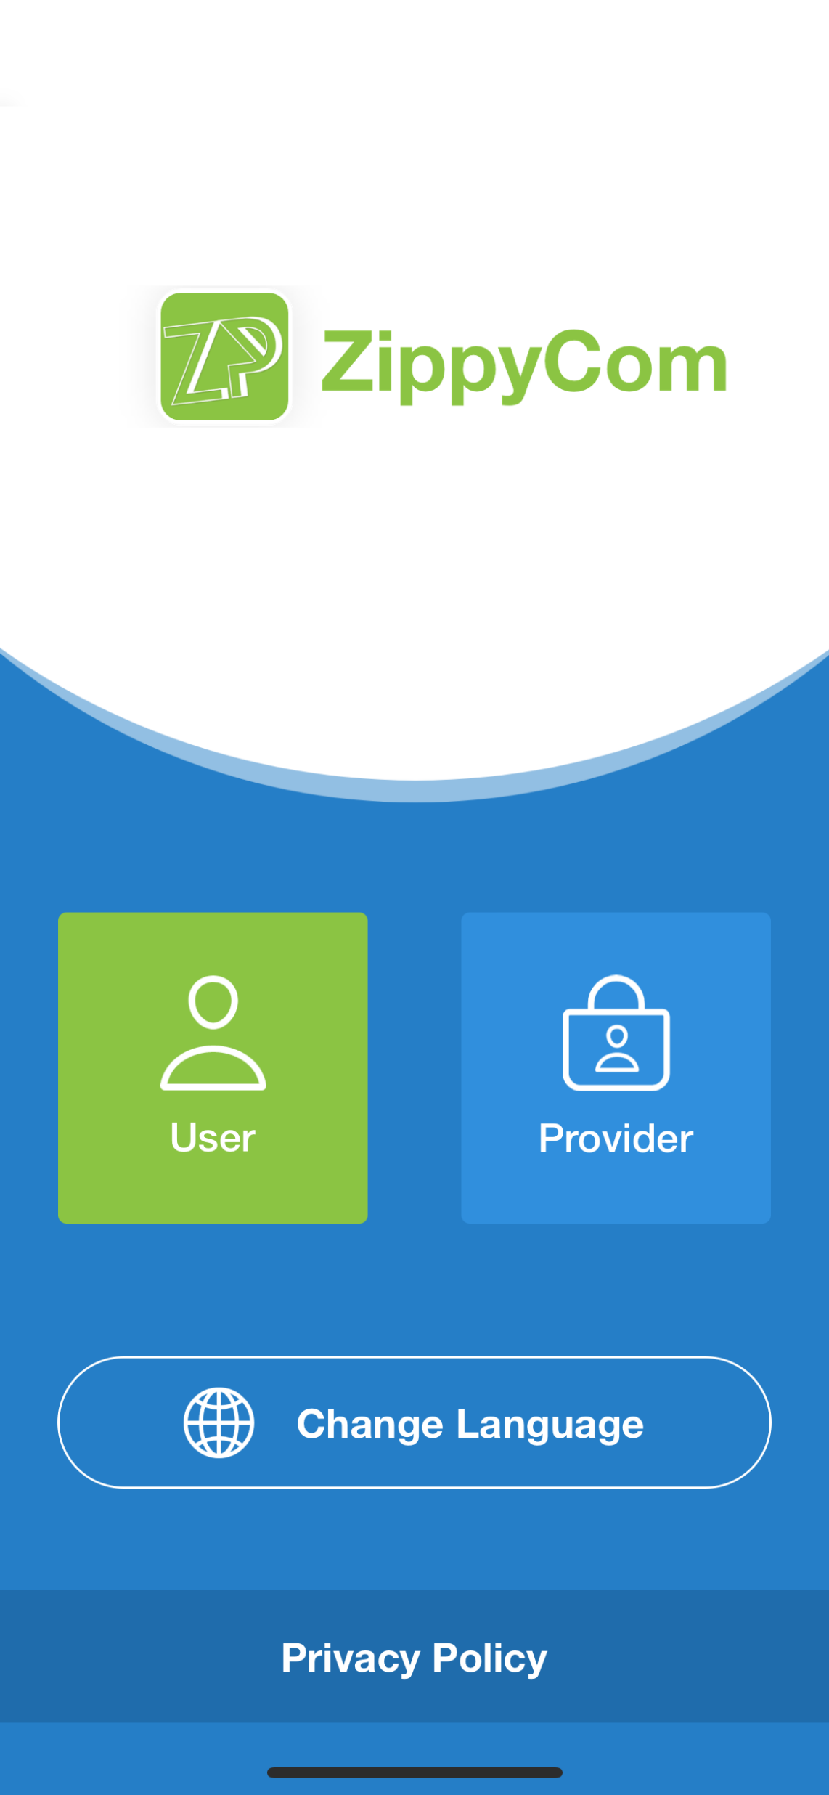

Slide 7

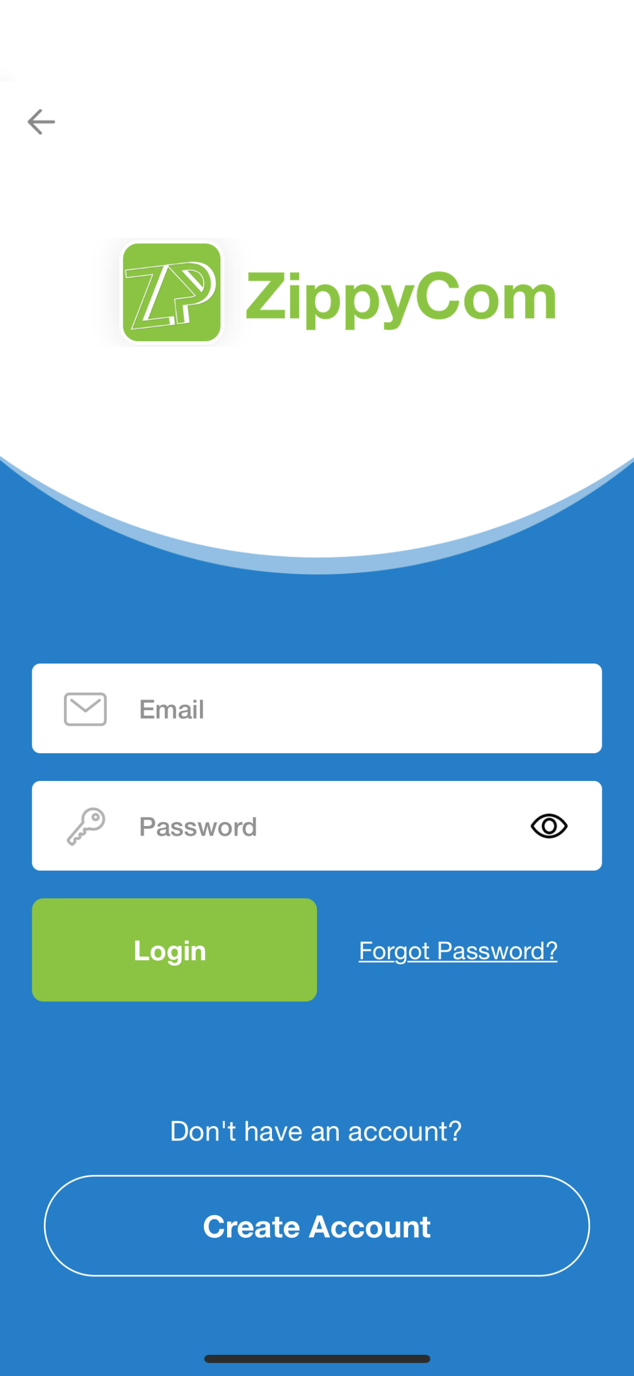

Slide 8
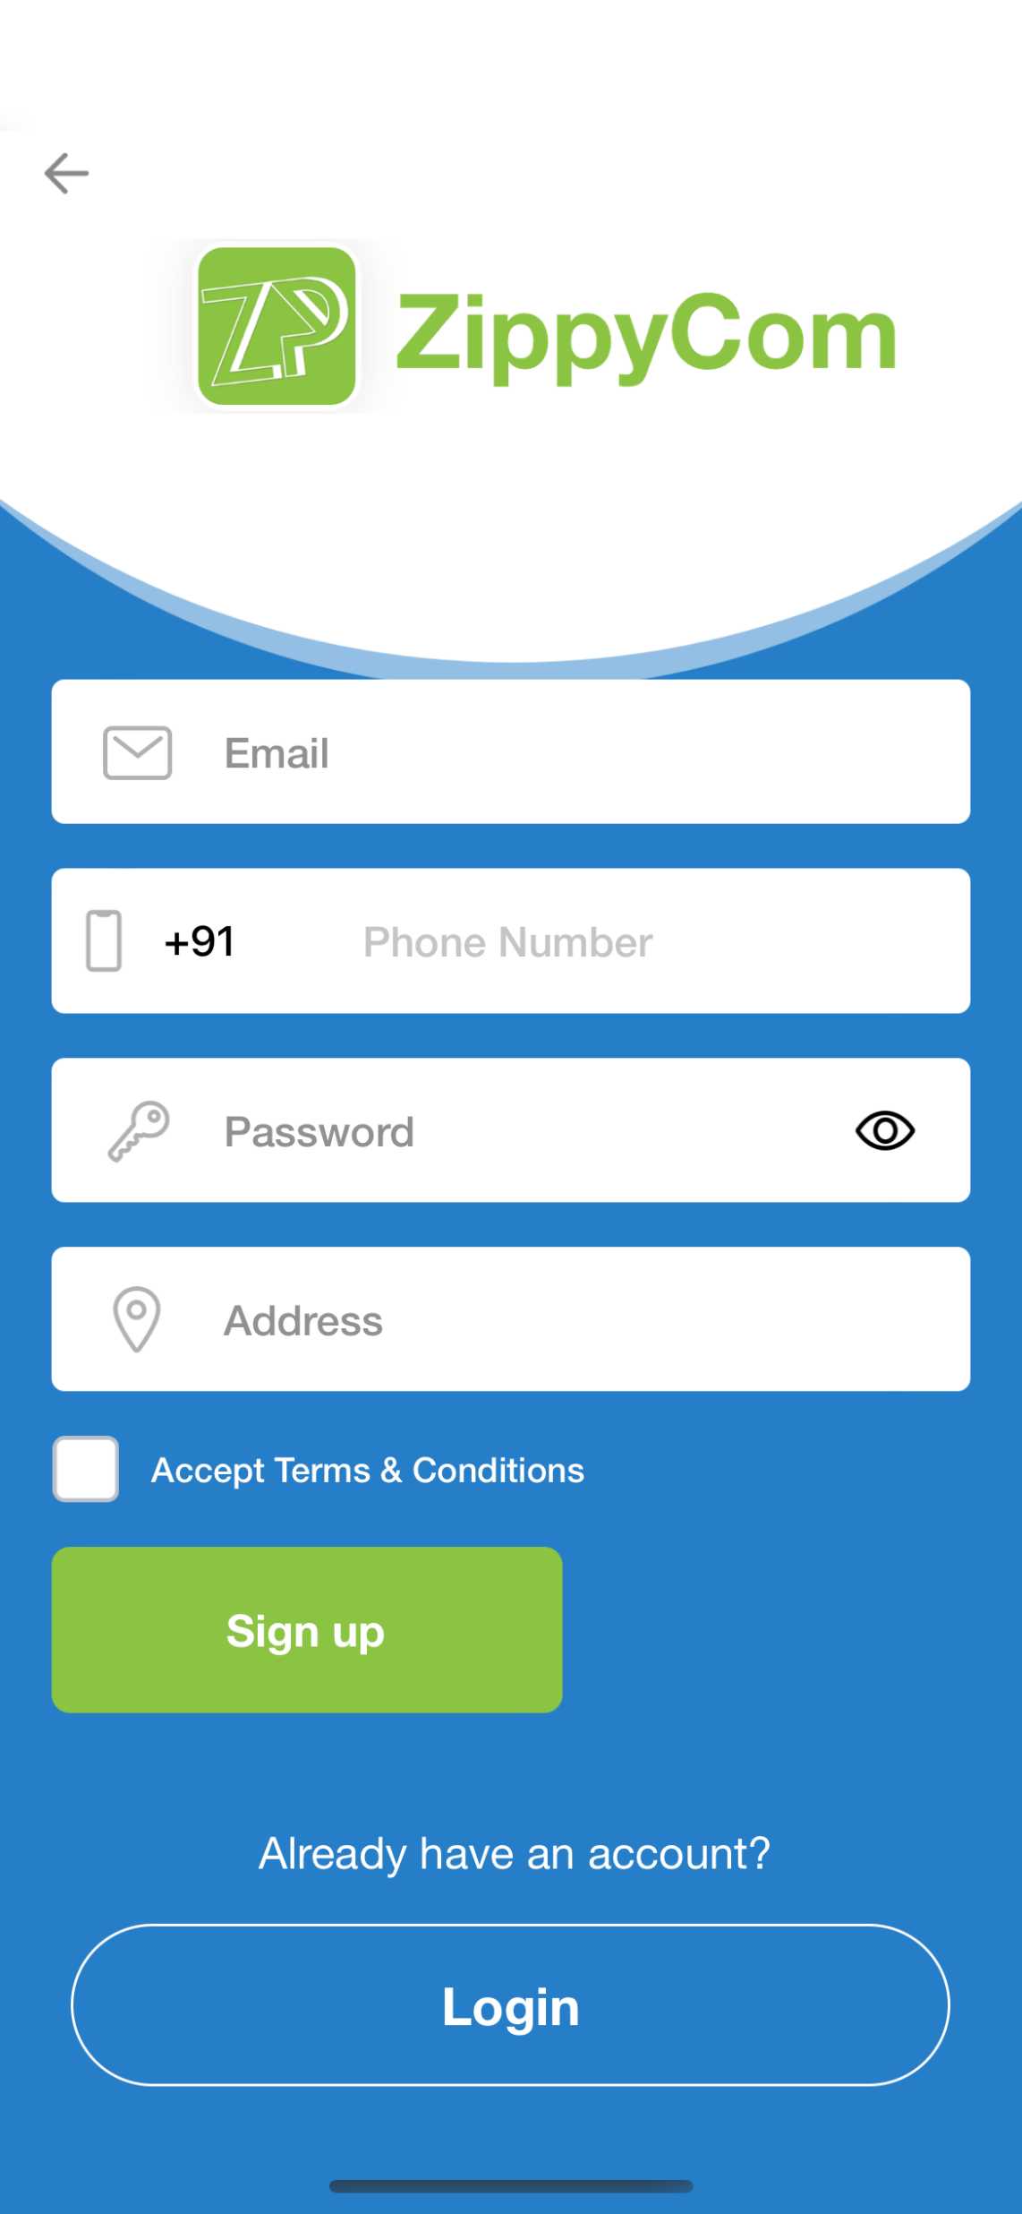
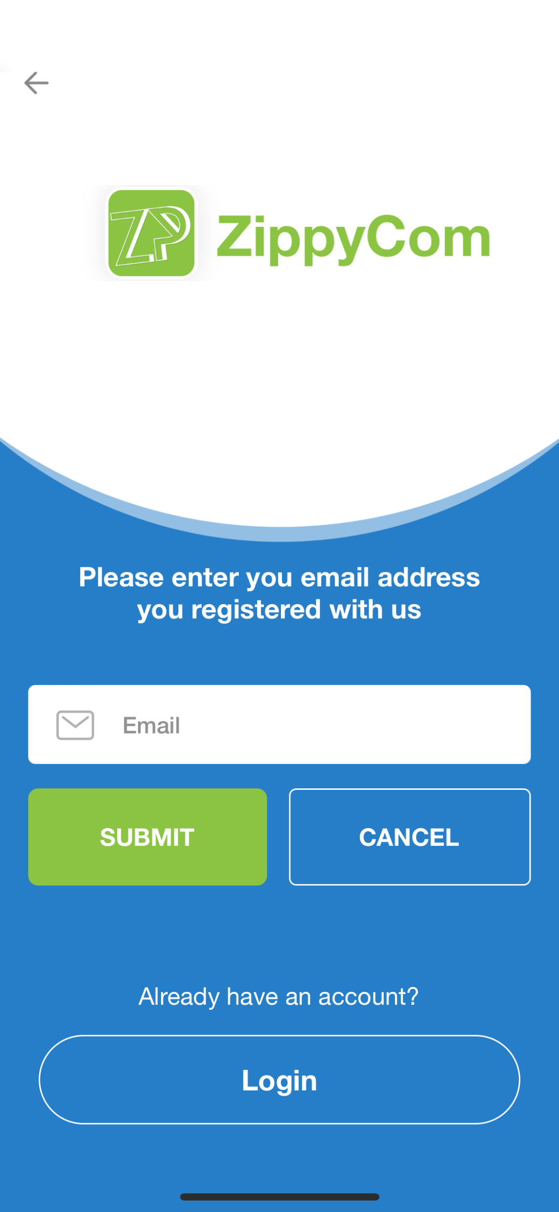

Slide 9
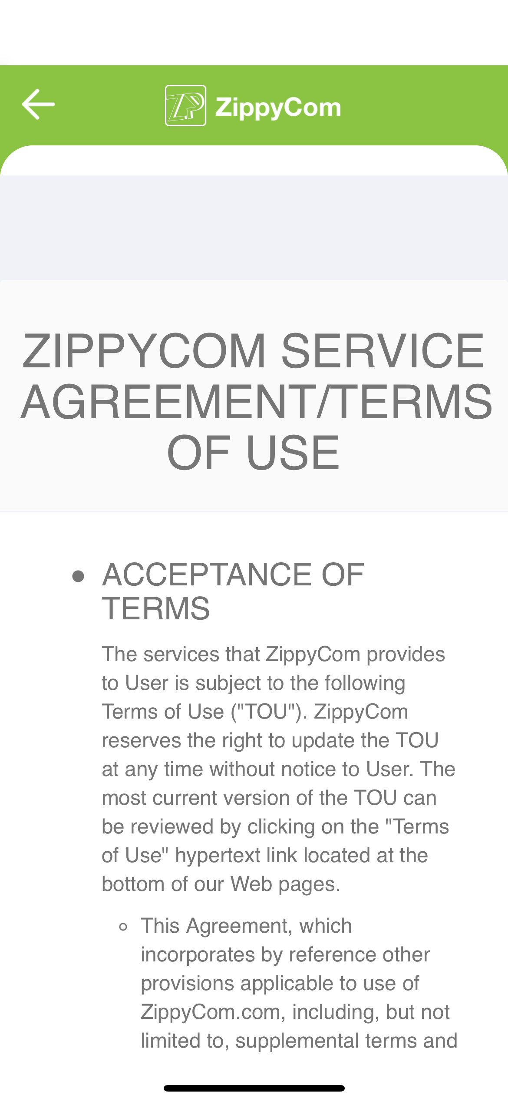
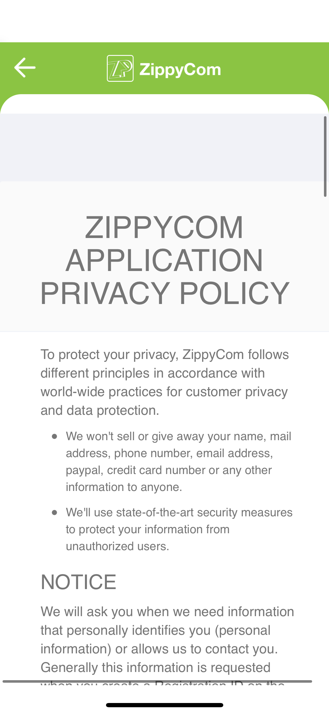

Slide 10
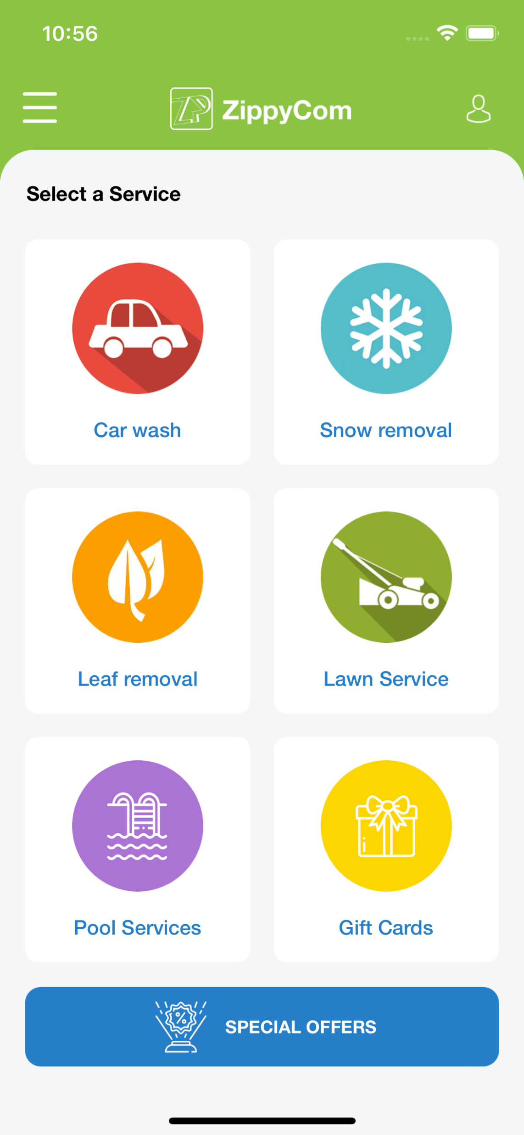

Slide 11
CONCLUSION
Because ZippyCom's services are available as a mobile app you can place your order, confirm job details, pay for your services & leave a review, all from the comfort of your home or office. All of our service providers are background checked.
In a hurry? With just one click you can have great service anytime & anywhere. Choose your Provider on the map to see which providers are working nearby, and select based on price & reviews.

Slide 12
THANK
YOU

